Slide 1
Creative
Questions
Probability + statistics Project CodingInvaders

Slide 2
Overview
Table bt_callinfo has been randomly divided into 5 different samples, called 5 small samples. The number in column sample_no represents the 5 different samples. You have to select any one sample out of 5 samples present in the bt_callinfo table and answer the below questions. Also, please reach out to the support team in case of any confusion or questions.
DATA LINK: https://docs.google.com/spreadsheets/d/1qHgR6Dci4TCQ7qIlRNBJ0o_aDSBdINeD_yQk5ShPuCc/edit?usp=sharing

Slide 3
Understanding the problems
01
Solve at least 2 questions from this project using any small sample(Choose any sample i.e 1 to 5 with sample_no column) and explain in the presentation if you find any difference in the statistics between the 10000 sample (bt_callinfo - original dataset) and small sample (Approx 2000 sample) which is created from bt_callinfo?
02
What is the probability of 12 customers rejecting the offer and then 1 customer accepting the offer?
03
Assume the marketing team launches a new campaign and 60 new customers accepted the offer in May. Is the rise in the number of accepted offers due to the latest campaign or due to random chance? Calculate the likelihood that the new campaign will result in more than 60 customers accepting the offer during May.
04
What are the chances/probability that if you pick any random customer, then the customer's age is less than or equal to 28 years old?

Slide 4

Koffi Offori
Eager Data analytics/scientist
83%
offori

Slide 5
When we visualize the number the difference between the sample and population is neglectable.
Average pop 3
Average samp 3
STDEV pop 1.409960481
STDEV samp 1.408954072
Median pop 3
Median samp 3

Slide 6
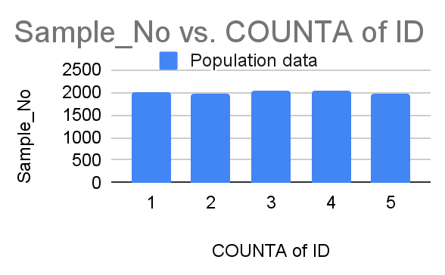
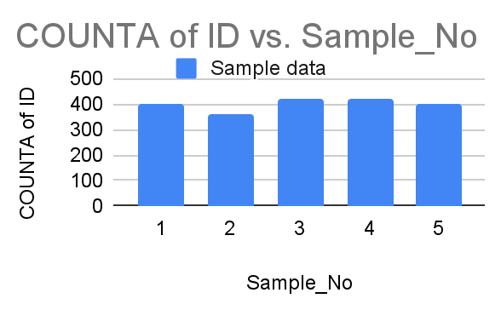
But here these both pictures show there is a little difference between the sample vs population. This means Random sampling is not accurate but closer to the original data so can be used to inference conclusion

Slide 7
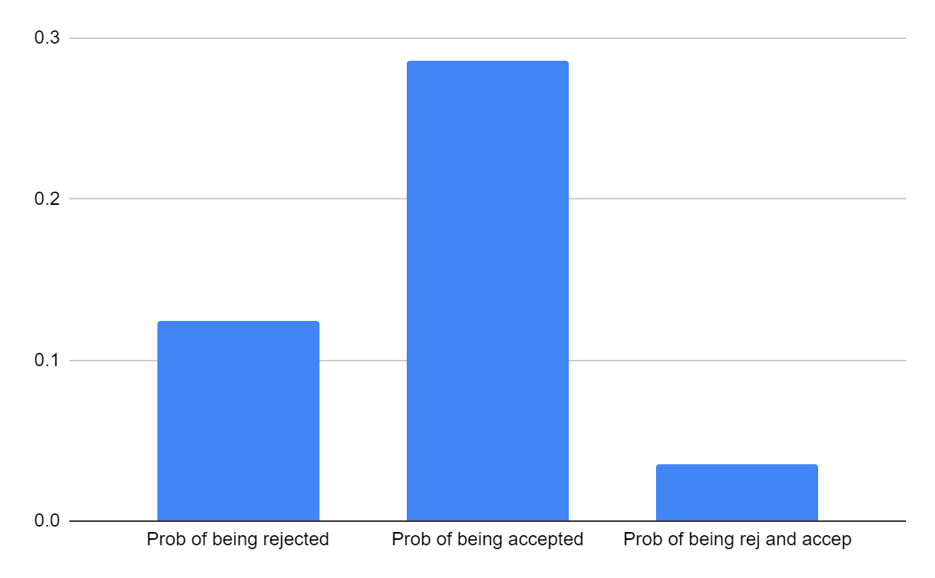
The likelihood of 12 being rejected and 1 accepted is very small. Means the chances to happen is very less to happen

Slide 8
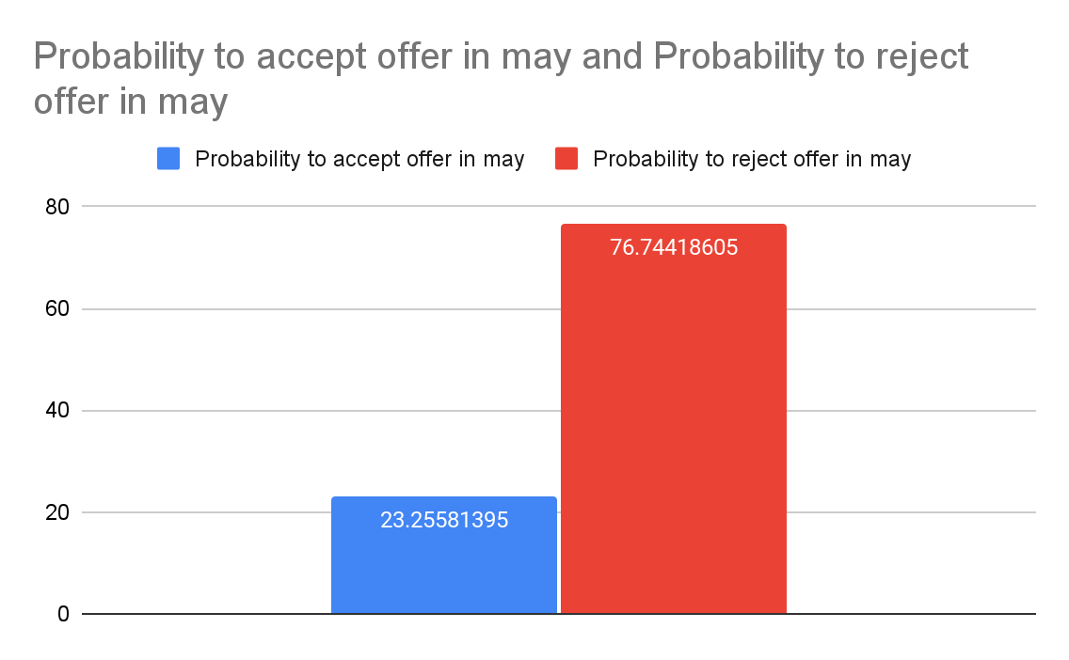

Slide 9
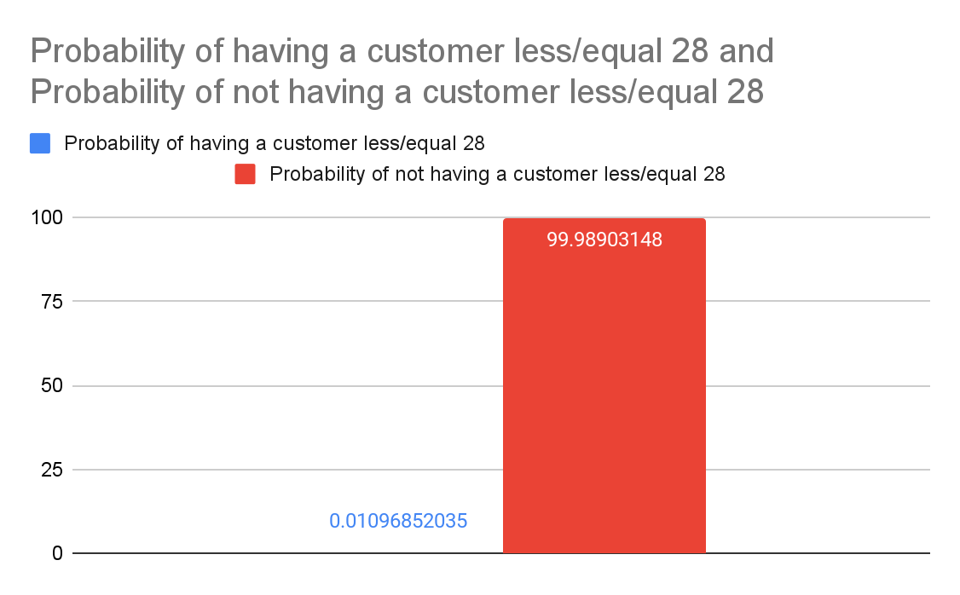

Slide 10
Thank you!

